Slide 1
Unit 3

Slide 2
Outline
Reading Summary
Unit 3 Self-Quiz : Videos Explanation
Definition
Formulas and Videos Review
Optional Extra Videos

Slide 3
Summary
Data can be described and presented in many different formats.
A statistical graph is a tool that helps you learn about the shape of the distribution of a sample.
Statisticians often start the analysis by graphing the data in order to get an overall picture of it.
The histogram is a frequently used method for displaying the distribution of continuous numerical data.
The box plot, or box-whisker plot, gives a good graphical overall impression of the concentration of the data.

Slide 4
Summary
The box plot, or box-whisker plot, gives a good graphical overall impression of the concentration of the data.
Outliers are values that do not t with the rest of the data and lie outside of the normal range.
The two most widely used measures of the central location of the data are the mean (average) and the median.
The median is generally a better measure of the center when there are extreme values or outliers because it is not a ected by the precise numerical values of the outliers.

Slide 5
Summary
The mean can be calculated by averaging the data points or it also can be calculated with the relative frequencies of the values that are present in the data.
One measure of the spread of the data is the interquartile range
the most important measure of spread is the standard deviation.

Slide 6
Unit 3 Self-Quiz : Videos Explanation
https://youtu.be/L8Ge-puuuq4
https://youtu.be/42tpVTRm0Gw
https://youtu.be/l9Gz63gz1ns
https://youtu.be/2314pO8N9to

Slide 7
Definition
Median: A number that separates ordered data into halves: half the values are the same number or smaller than the median and half the values are the same number or larger than the median. The median may or may not be part of the data.
Quartiles: The numbers that separate the data into quarters. Quartiles may or may not be part of the data. The second quartile is the median of the data.
Outlier: An observation that does not fit the rest of the data. Interquartile Range (IQR) : The distance between the third quartile (Q3) and the first quartile (Q1).
IQR = Q3 - Q1.

Slide 8
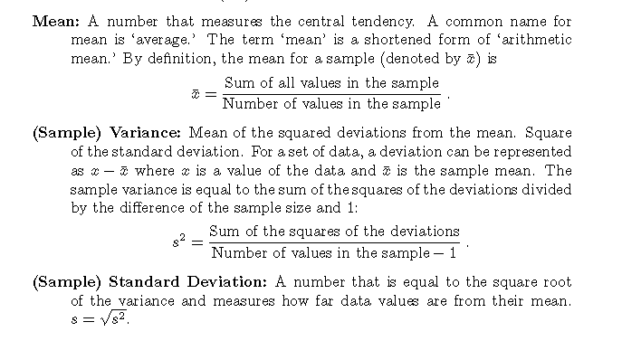
Definition

Slide 9
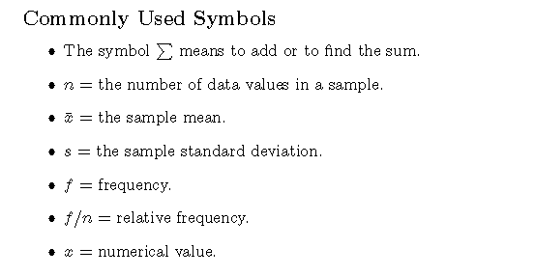
Formulas and Videos Review
https://youtu.be/Vrg16RWykEI

Slide 10
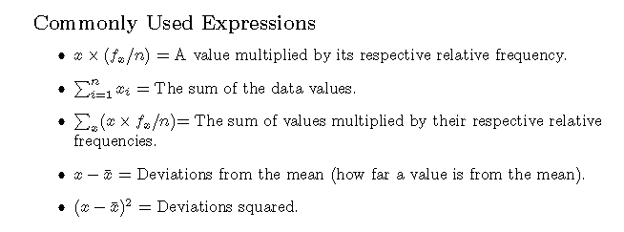
Formulas and Videos Review
https://youtu.be/Vrg16RWykEI

Slide 11
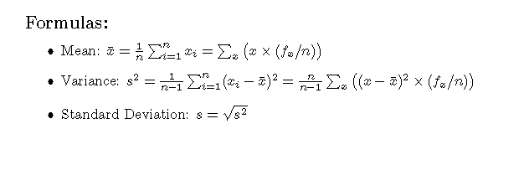
Formulas and Videos Review
https://youtu.be/Vrg16RWykEI
https://youtu.be/-v1axLZ9DqY

Slide 12
Optional Extra Videos
https://www.khanacademy.org/math/statistics-probability/summarizing-quantitative-data/modal/v/statistics-intro-mean-median-and-mode
https://www.khanacademy.org/math/statistics-probability/summarizing-quantitative-data/modal/v/mean-median-and-mode
https://www.khanacademy.org/math/statistics-probability/summarizing-quantitative-data/modal/v/comparing-distribution-means
https://www.khanacademy.org/math/statistics-probability/summarizing-quantitative-data/modal/v/comparing-means-and-medians
https://www.khanacademy.org/math/statistics-probability/summarizing-quantitative-data/modal/v/impact-on-median-and-mean-when-removing-lowest-value-example
https://www.khanacademy.org/math/statistics-probability/summarizing-quantitative-data/modal/v/impact-on-median-and-mean-when-increasing-highest-value
https://www.khanacademy.org/math/statistics-probability/summarizing-quantitative-data/modal/v/using-mean-to-find-missing-value

Slide 13
Optional Extra Videos
https://www.khanacademy.org/math/statistics-probability/summarizing-quantitative-data/modal/v/median-and-range-puzzle
https://www.khanacademy.org/math/statistics-probability/summarizing-quantitative-data/modal/v/calculating-interquartile-range-iqr
https://www.khanacademy.org/math/statistics-probability/summarizing-quantitative-data/modal/v/range-variance-and-standard-deviation-as-measures-of-dispersion
https://www.khanacademy.org/math/statistics-probability/summarizing-quantitative-data/modal/v/variance-of-a-population
https://www.khanacademy.org/math/statistics-probability/summarizing-quantitative-data/modal/v/population-standard-deviation
https://www.khanacademy.org/math/statistics-probability/summarizing-quantitative-data/modal/v/mean-and-standard-deviation-versus-median-and-iqr

Slide 14
Optional Extra Videos
https://www.khanacademy.org/math/statistics-probability/summarizing-quantitative-data/modal/v/statistics-alternate-variance-formulas
https://www.khanacademy.org/math/statistics-probability/summarizing-quantitative-data/modal/v/sample-variance
https://www.khanacademy.org/math/statistics-probability/summarizing-quantitative-data/modal/v/sample-standard-deviation-and-bias
https://www.khanacademy.org/math/statistics-probability/summarizing-quantitative-data/modal/v/another-simulation-giving-evidence-that-n-1-gives-us-an-unbiased-estimate-of-variance
https://www.khanacademy.org/math/statistics-probability/summarizing-quantitative-data/modal/v/simulation-showing-bias-in-sample-variance
https://www.khanacademy.org/math/statistics-probability/summarizing-quantitative-data/modal/v/simulation-providing-evidence-that-n-1-gives-us-unbiased-estimate

Slide 15
Optional Extra Videos
https://www.khanacademy.org/math/statistics-probability/summarizing-quantitative-data/modal/v/review-and-intuition-why-we-divide-by-n-1-for-the-unbiased-sample-variance
https://www.khanacademy.org/math/statistics-probability/summarizing-quantitative-data/modal/v/box-and-whisker-plot-exercise-example
https://www.khanacademy.org/math/statistics-probability/summarizing-quantitative-data/modal/v/another-example-constructing-box-plot
https://www.khanacademy.org/math/statistics-probability/summarizing-quantitative-data/modal/v/constructing-a-box-and-whisker-plot
https://www.khanacademy.org/math/statistics-probability/summarizing-quantitative-data/modal/v/reading-box-and-whisker-plots
https://www.khanacademy.org/math/statistics-probability/summarizing-quantitative-data/modal/v/interpreting-box-plots
https://www.khanacademy.org/math/statistics-probability/summarizing-quantitative-data/modal/v/judging-outliers-in-a-dataset

Slide 16
Optional Extra Videos
https://www.khanacademy.org/math/statistics-probability/summarizing-quantitative-data/modal/v/range-and-mid-range
https://www.khanacademy.org/math/statistics-probability/summarizing-quantitative-data/modal/v/mean-absolute-deviation
https://www.khanacademy.org/math/statistics-probability/summarizing-quantitative-data/modal/v/mean-absolute-deviation-example

